Slide 1
Sewer Line Vulnerabilities in Los Angeles
Michelle Ramirez
SSCI 582: Spatial Databases
May 3rd, 2018

Slide 2
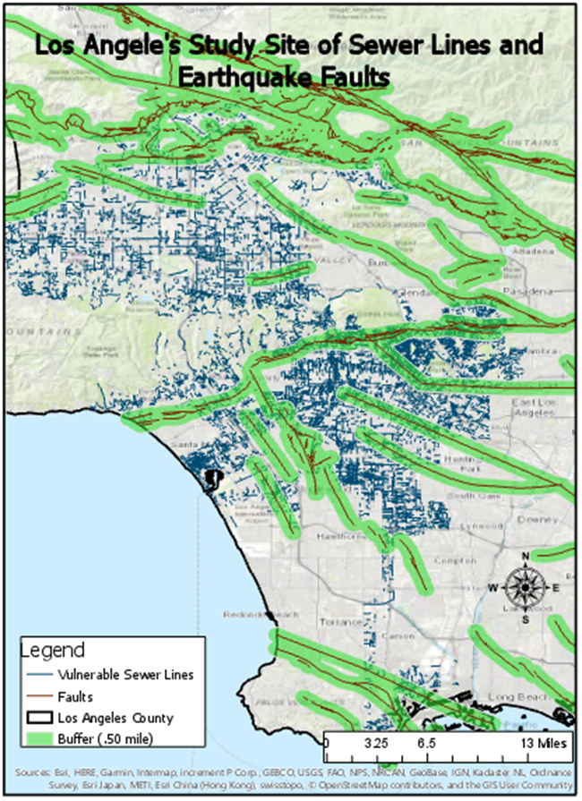
Study Area
According the Department of Public Works , the city manages approximately 9,500 miles of sewer lines
According to the Bureau of Street Services the city manages approximately 6,500 miles of roads
1994 Northridge earthquake was an 6.7 magnitude and cause $44 billion in damages

Slide 3
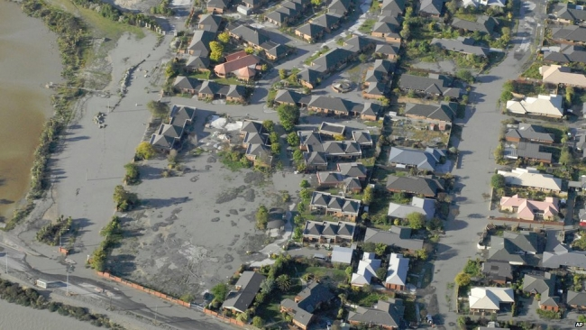
Reasoning
Prepare for the future to mitigate damages
Deaths
Billions in damages
Prevent liquefaction
When loosen soil and liquids mix create a liquid that can cause skinning
626 potential locations
Notes:
Christchurch, New Zealand 2011 earthquake

Slide 4
Data
United States Geological Survey
Los Angeles Open Data - City of Los Angeles
Data Catalog
GeoHub
Some of the files were so large they had to be reduced
Six data files were download
5 shapefiles
1 CVS file

Slide 5
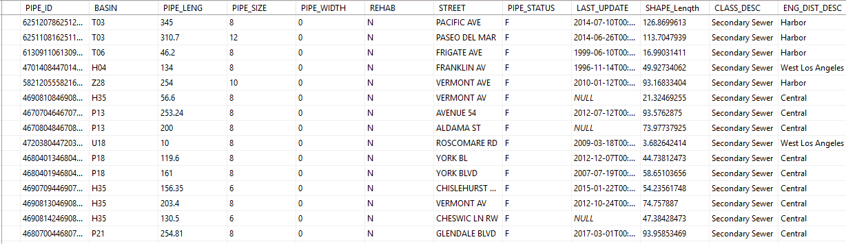
Methods
Excel
Much of the data was cleaned
SQL Server Management Studio
Relationships
Queries
ArcGIS Pro
Clip
Buffer

Slide 6
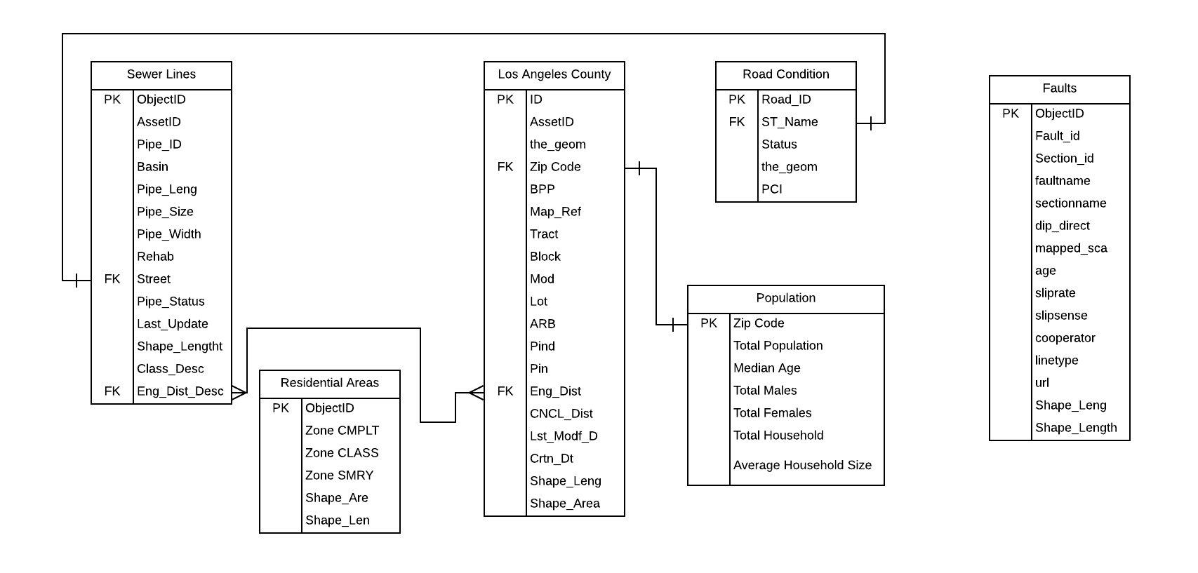
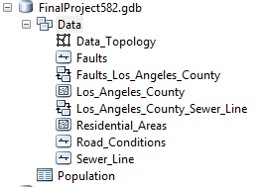
Database
Relationships
2 (1 TO 1 )
1 (1 TO MANY)
Some of the data could not create relationships
What the relationship accomplished?
Selected the Columns such as Pipe_STATUS, LAST_UPDATE, ST_NAME, and Status
Allowed the data to be more refined

Slide 7
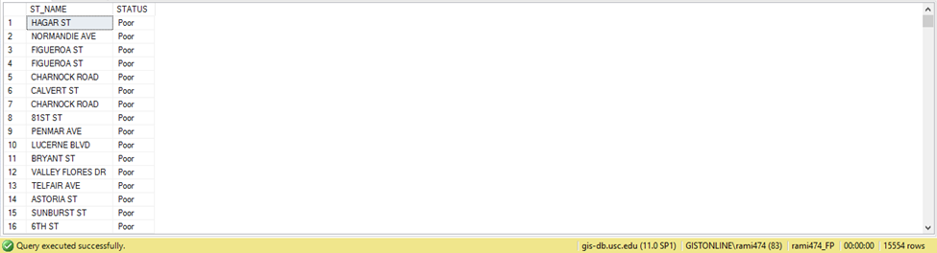
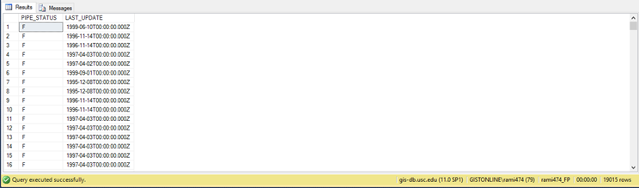
SQL Queries
I.
USE rami474_FP
SELECT [ST_NAME],[STATUS]
FROM dbo.[Road Conditions]
WHERE STATUS = ‘poor’;
II.
USE rami474_FP
SELECT [PIPE_STATUS], [LAST_UPDATE]
FROM dbo.[SEWER LINES]
WHERE PIPE_STATUS = ‘F’ AND LAST_UPDATE < ‘2000’;
Notes:
15,000/72,000 road
19,050/160,370 sewer

Slide 8
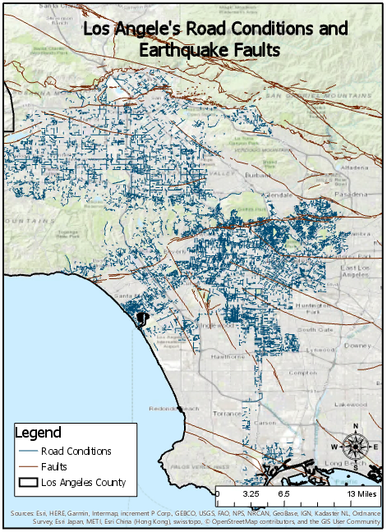
Map 1- Roads

Slide 9

Map 2- Sewer Lines

Slide 10
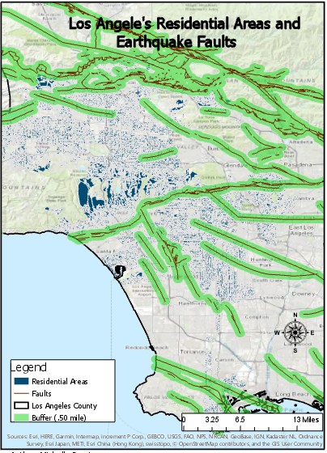
Map 3- Residential Areas

Slide 11
Conclusion
Los Angeles need to update its infrastructure
Poor Road Conditions
Poor Sewer line maintenance
Cause billions of damages
The database needs to be improved such as better data with more useful information
A updated database would proved better data for more analysis and more relationships

Slide 12
What went wrong?
I wish I could have found better data on faults and their magnitudes
Data that was collected on manholes was not usable so it was excluded
Do more analysis closer to faults
Roads
Sewer lines
Density of populations

Slide 13
Any Questions?

